Slide 1
Lists & Exception Handling

Slide 2
Points for recap…
Do you remember these concepts? Yes…. No… Maybe..
Use of Parameters
Declaring and invoking Methods
Use of Constructors and Methods in different and many classes
Using OOP concepts in coding
Difference between Constructors, Methods, Parameters and Properties

Slide 3
//Make a shopping list
//Add 7 items
//Remove one using the name
//Remove another using the index
//Insert another item
//Add a comment to two of your items
//Check the number of items on the list
//Use a for loop to output the items on the console
//Check whether a removed item is on the list
//Check whether an existing item is on the list
//Have a decent Output Display
// (10 Marks)

Slide 4
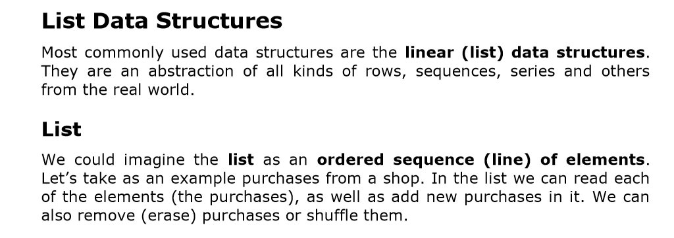

Slide 5
Abstract Data Structure "List"
Let’s now give a more strict definition of the structure list: List is a linear data structure, which contains a sequence of elements.
The list has the property length (count of elements) and its elements are arranged consecutively.
The list allows adding elements on different positions, removing them and incremental crawling.

Slide 6
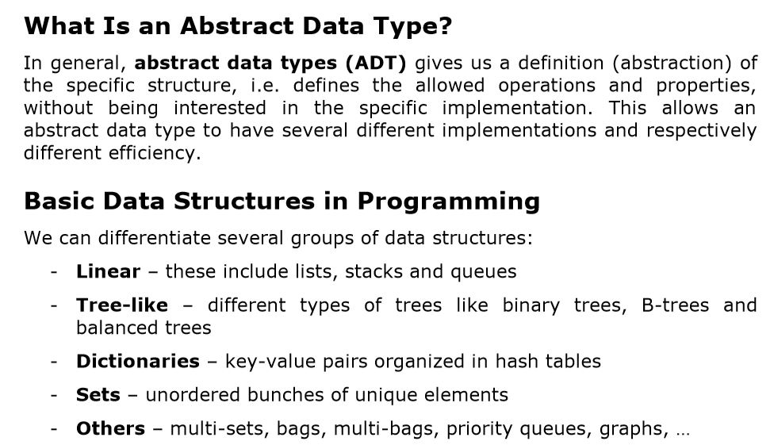

Slide 7
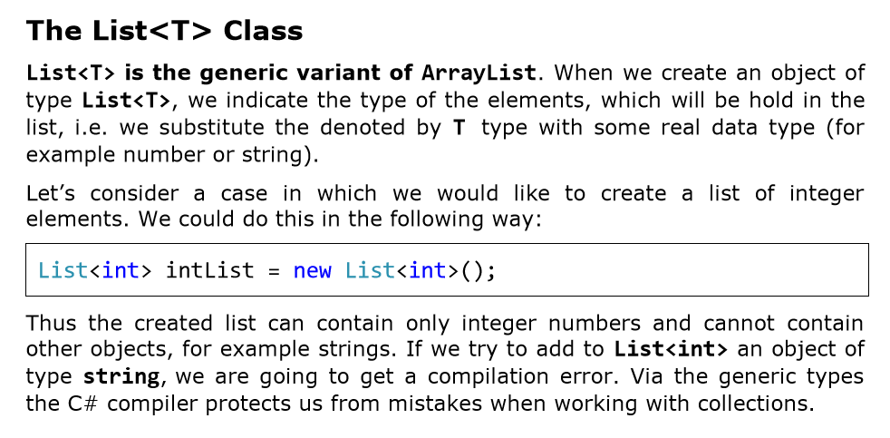

Slide 8
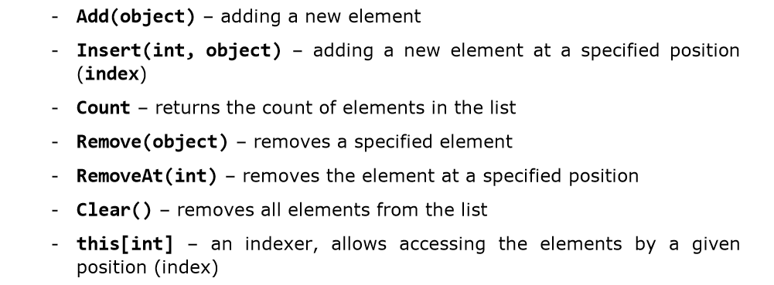
Class members we may use.

Slide 9
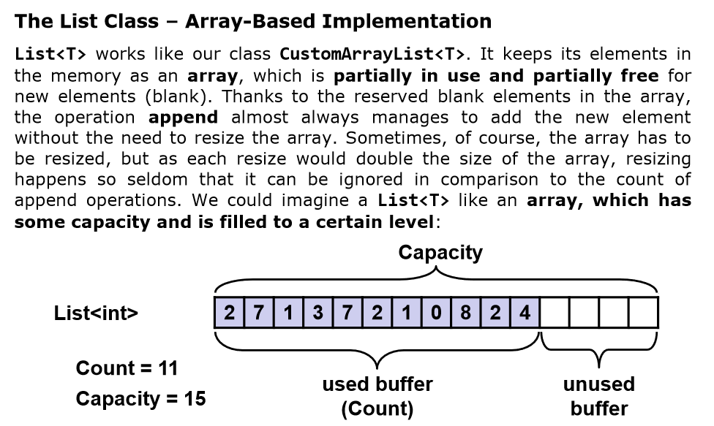

Slide 10
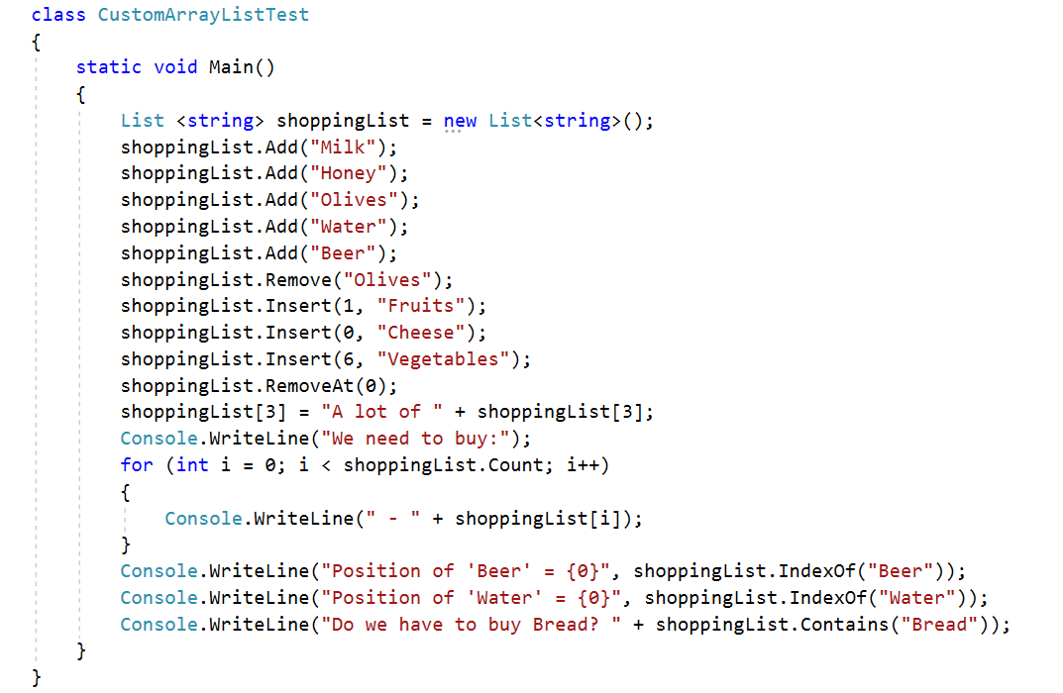

Slide 11
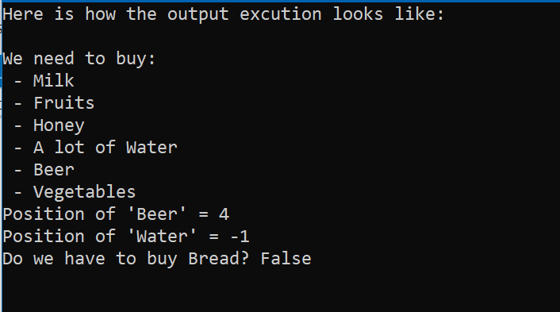
Console Output

Slide 12
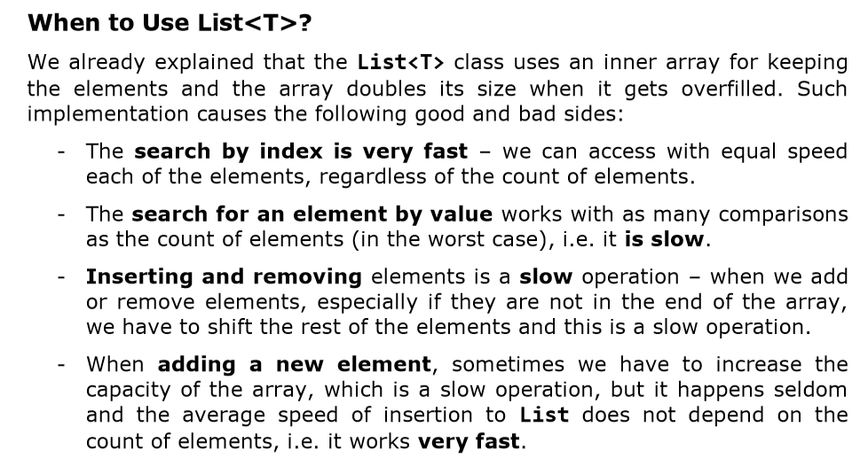

Slide 13
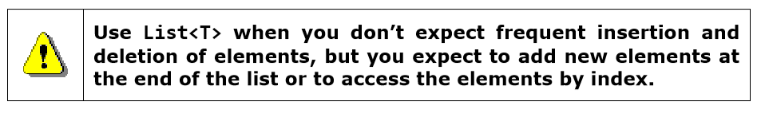

Slide 14
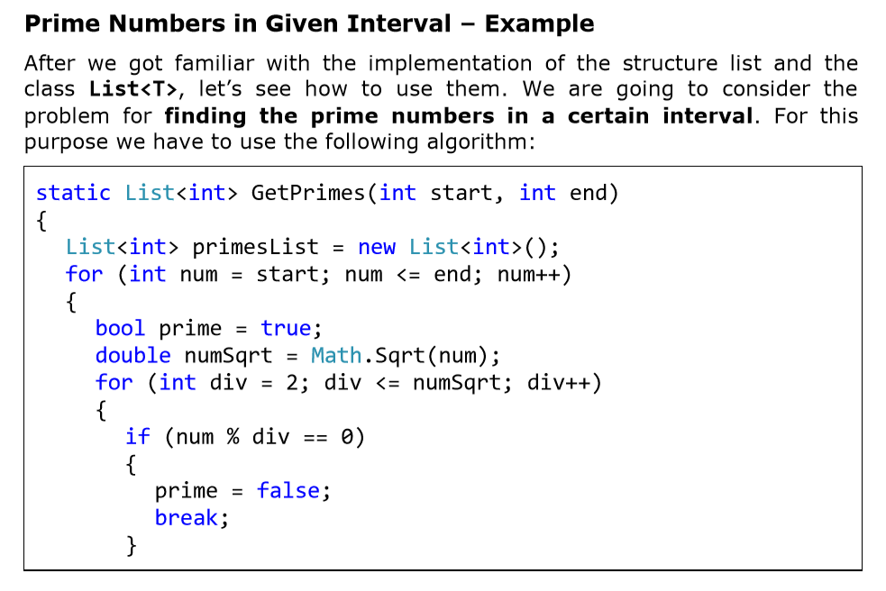

Slide 15
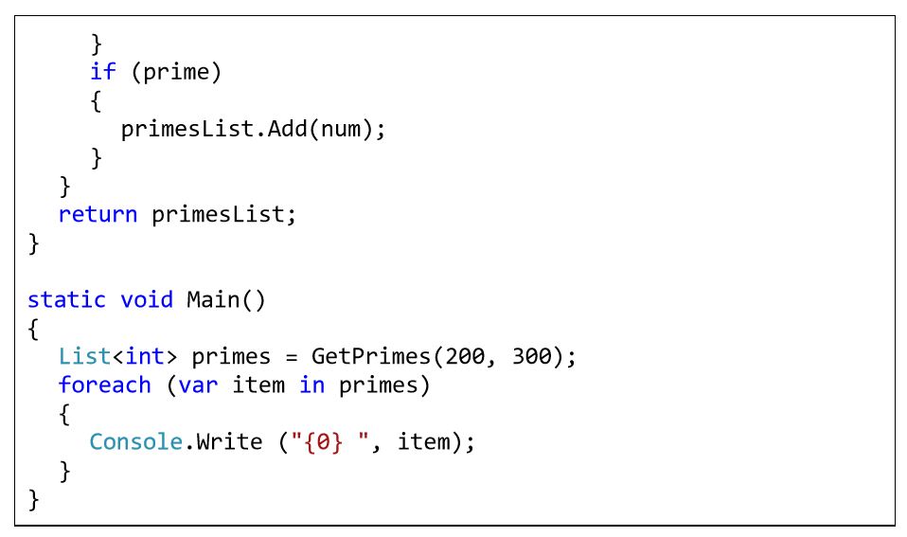

Slide 16
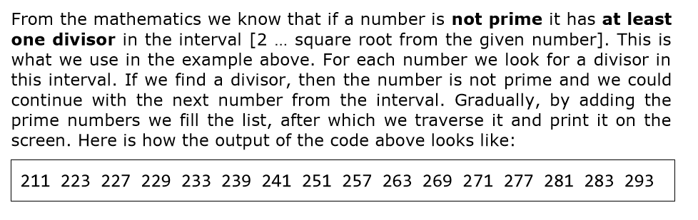

Slide 17
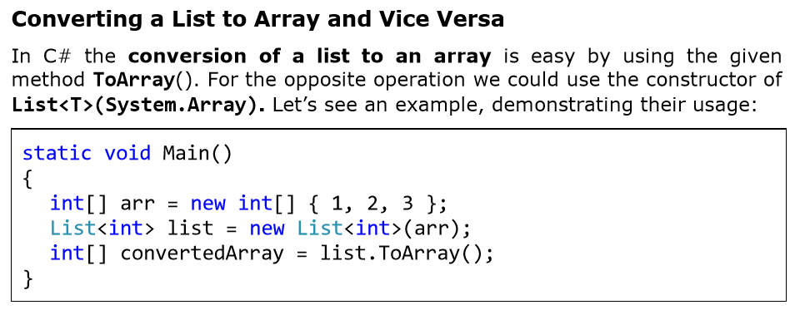

Slide 18
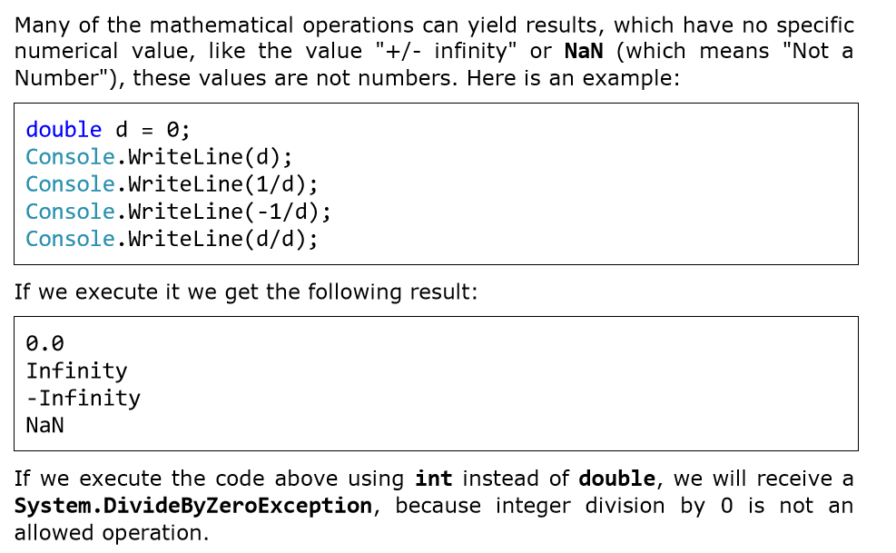

Slide 19
Exception Handling
(Should be handled exceptionally)

Slide 20
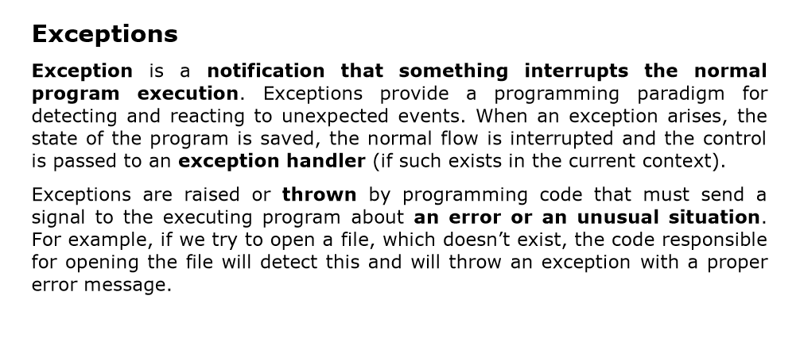

Slide 21
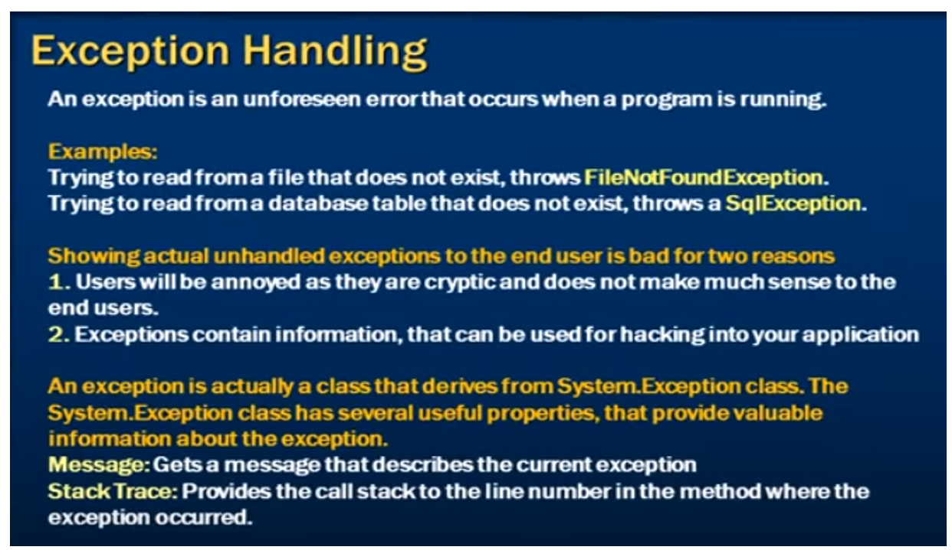

Slide 22
Catching and Handling Exceptions
Exception handling is a mechanism, which allows exceptions to be thrown and caught. This mechanism is provided internally by the CLR (Common Language Runtime).
Parts of the exception handling infrastructure are the language constructs in C# for throwing and catching exceptions. CLR takes care to propagate each exception to the code that can handle it.
In OOP, it is recommended to use exceptions for managing error situations or unexpected events that may arise during a program execution

Slide 23
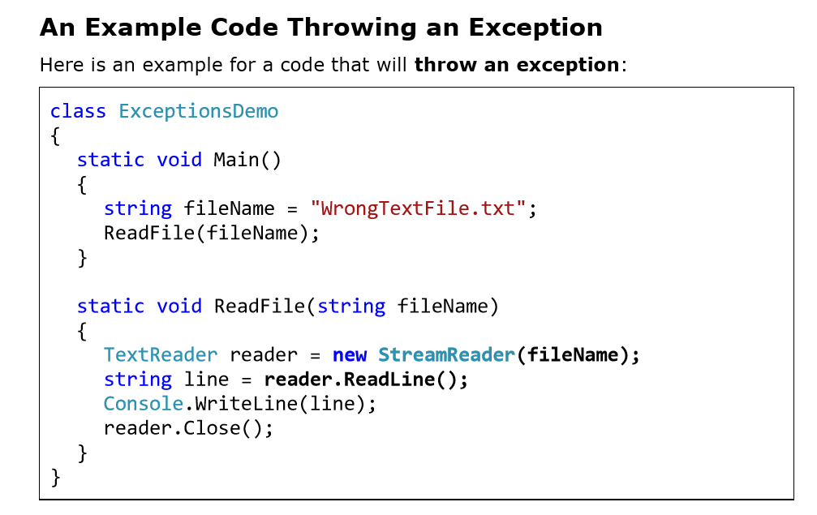

Slide 24
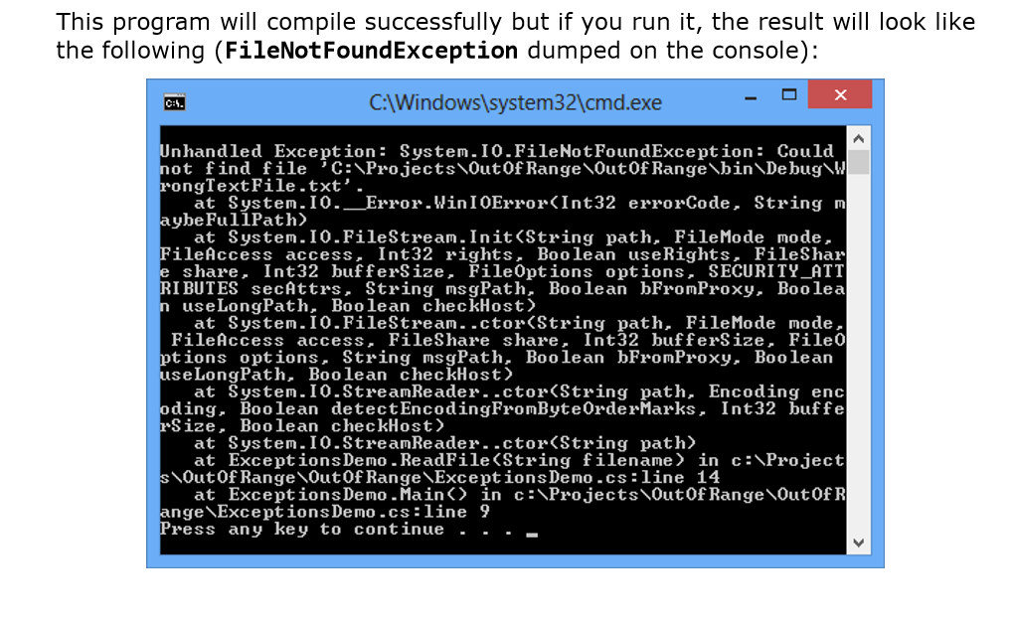

Slide 25
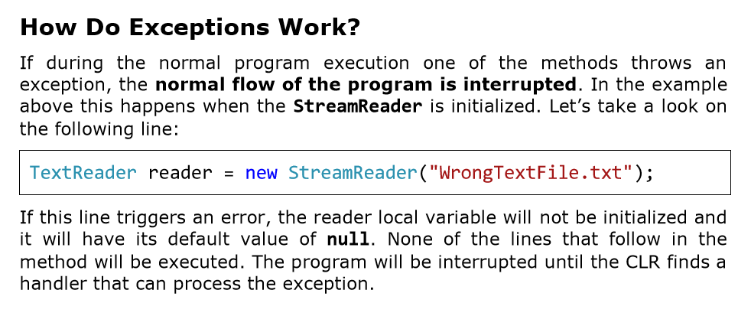

Slide 26
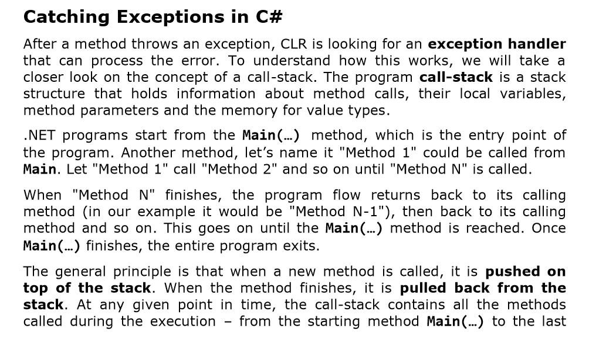

Slide 27
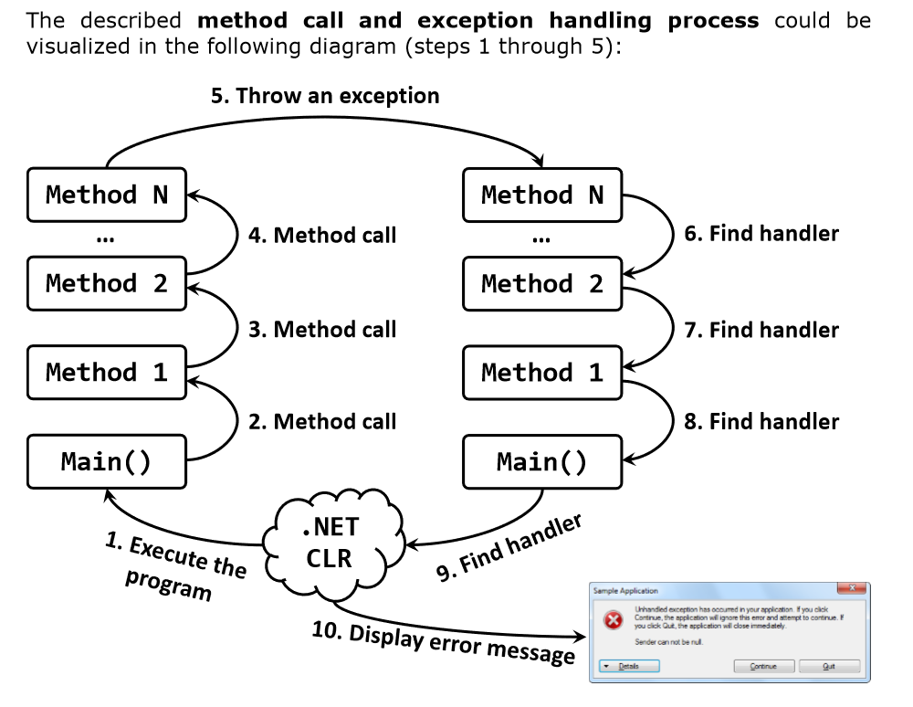

Slide 28
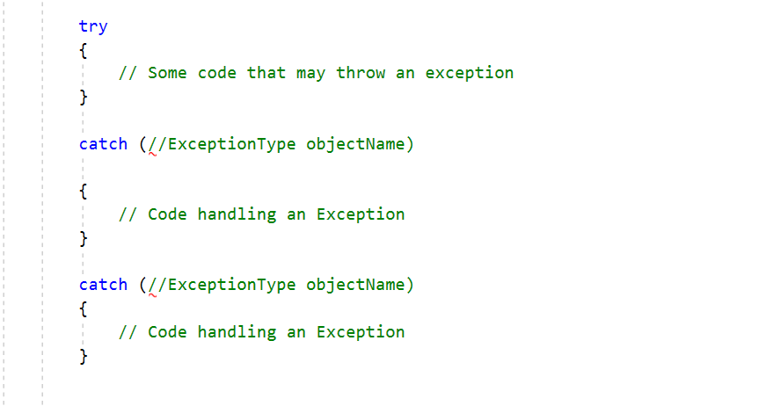
The try-catch Programming Construct

Slide 29
The try-catch construct consists of one try block and one or more catch blocks. Within the try block we put the code that could throw exceptions. The ExceptionType in the catch block must be a type, derived from System.Exception or the code wouldn’t compile.
The expression within brackets after catch is also a declaration of a variable, thus inside the catch block we can use objectName to use the properties of the exception or call its methods.

Slide 30
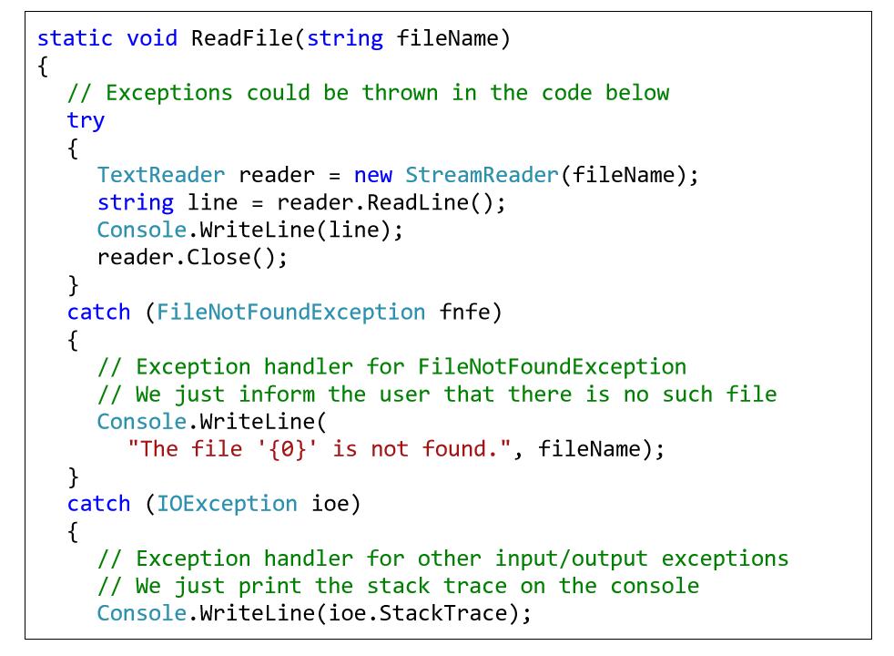
Catching Exceptions – Example

Slide 31
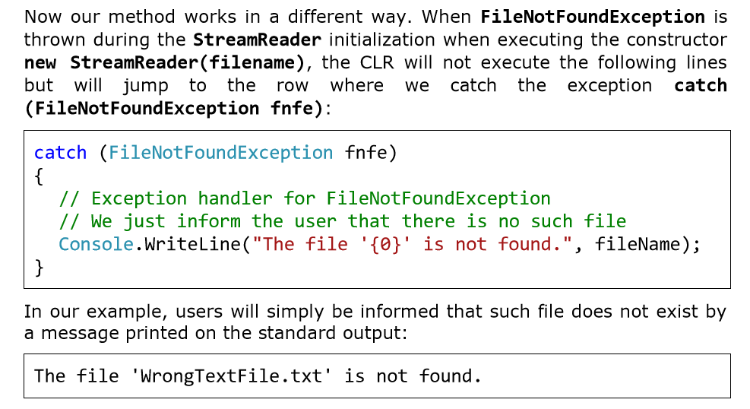

Slide 32
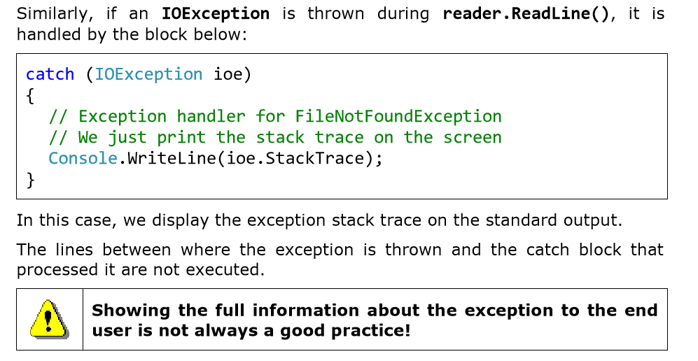

Slide 33
Stack trace
The stack trace contains detailed information about the exception including where exactly it occurred in the program.
The stack trace is very useful for programmers when they try to understand the problem causing the exception.
The information in the stack trace is very technical and is designed to be used by programmers and system administrators and not by the end users. During debugging the stack trace is a priceless tool.

Slide 34
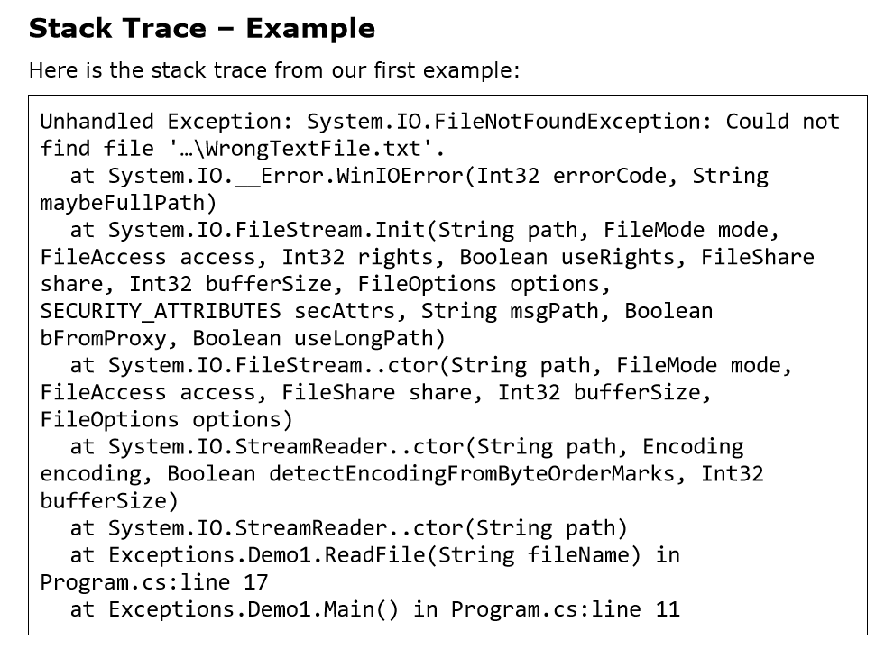

Slide 35
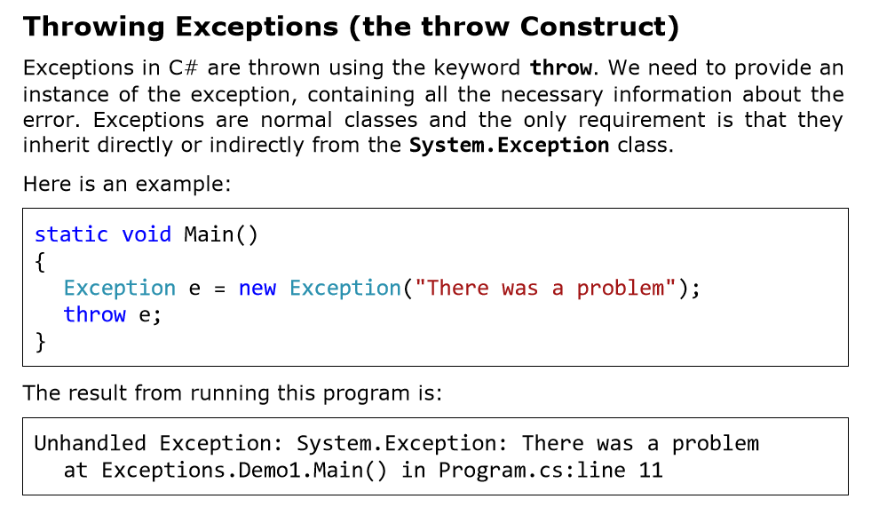

Slide 36
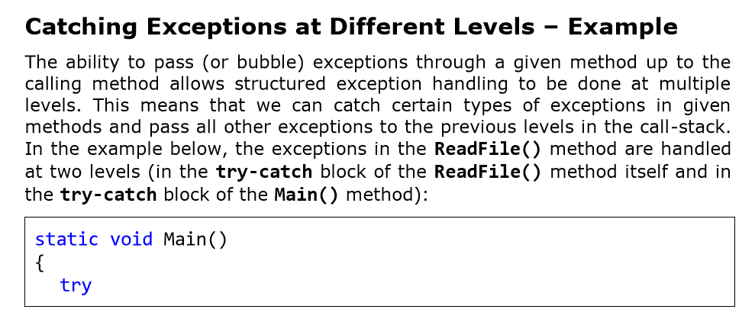

Slide 37
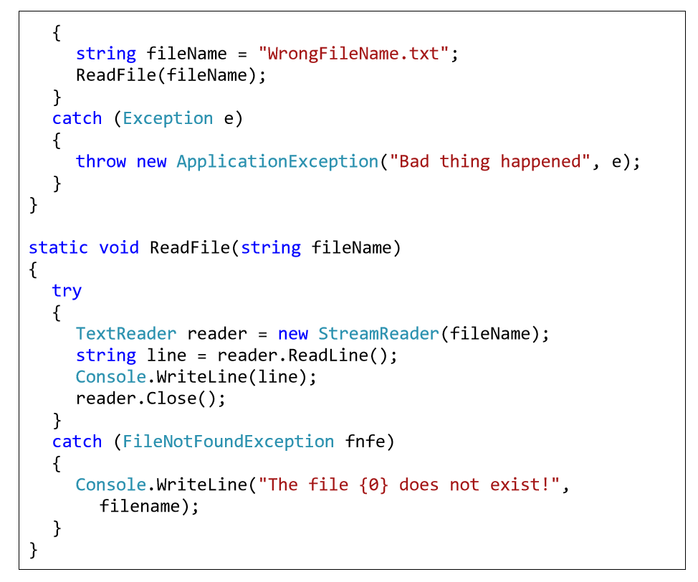

Slide 38
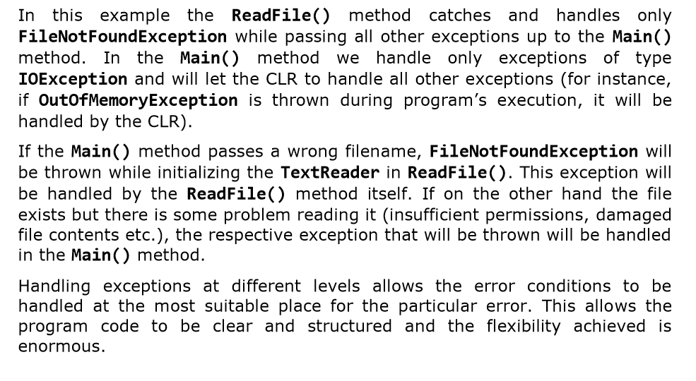

Slide 39
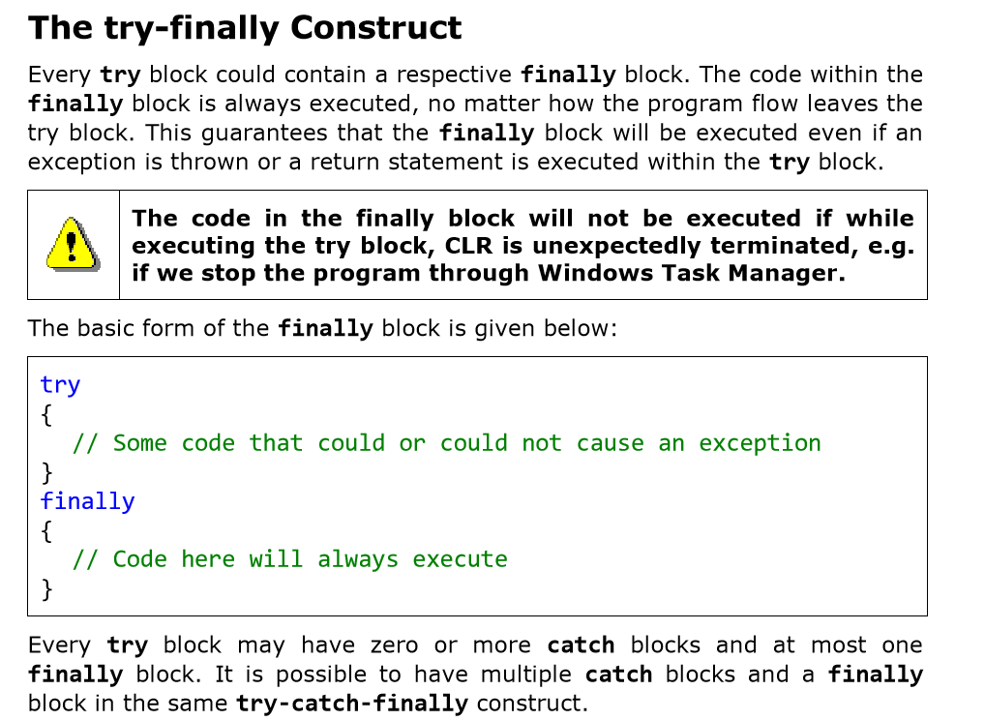

Slide 40
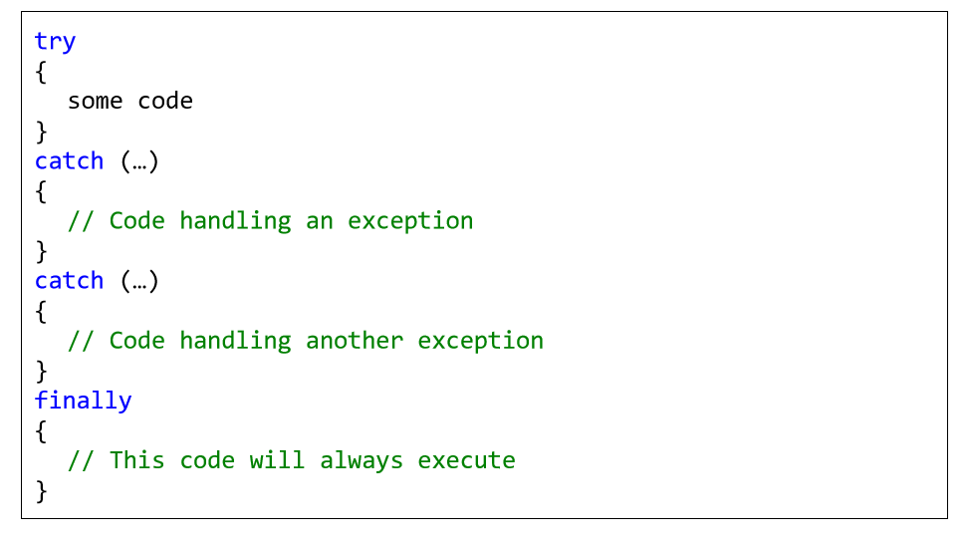

Slide 41
The End
Ooko Emmanuel

